Slide 1



Royal College of Music Museum
Sound Collectors – KS2
How is sound made?

Slide 2

Place your fingertips on your throat and speak.
What happens?
Sounds are made when objects vibrate.
We can't see vibrations, but if we could they would look like this.
A sound wave

Slide 3


The air around us is made up of tiny molecules that we can't see.
These air molecules hit each other as the sound moves through the air – a bit like this.

Slide 4

Look familiar?

Slide 5
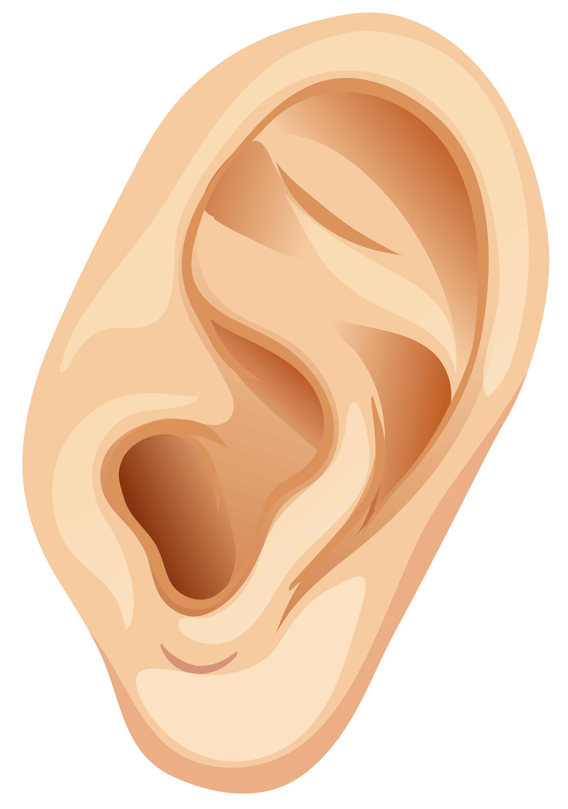
The vibrations make their way to enter your ear causing the ear drum inside it to vibrate. This is how you hear a sound.

Slide 6
Musical instruments make sound in different ways.
Instruments with strings are plucked or bowed.

Slide 7
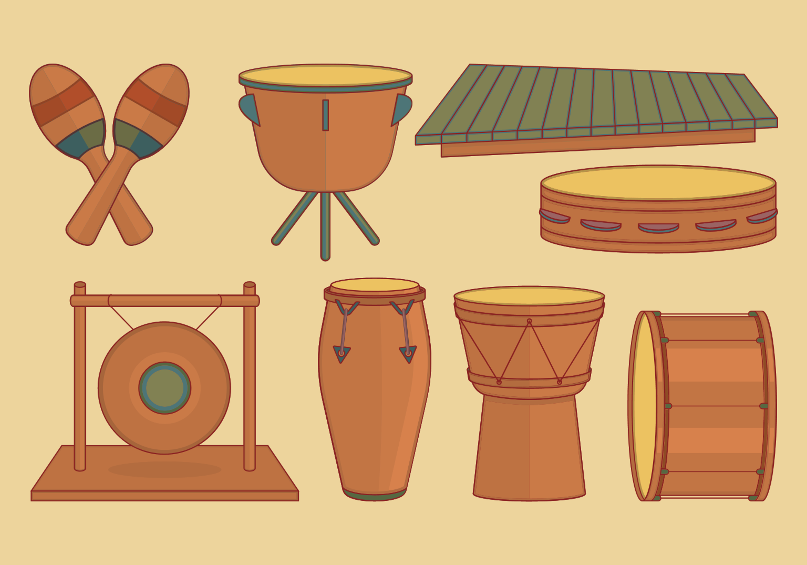
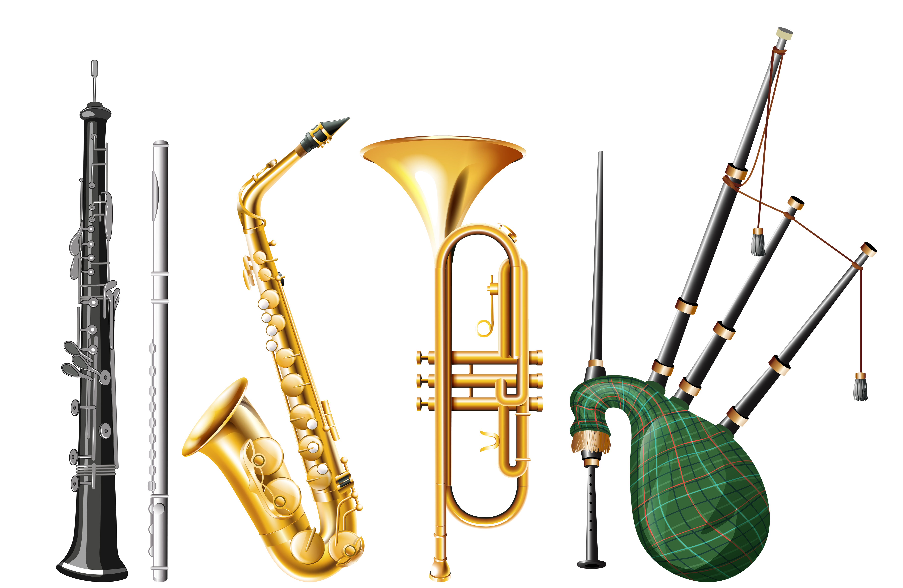
Percussion instruments like drums or bells are hit or shaken.
You blow air into woodwind and brass instruments.

Slide 8
What is pitch?

Slide 9
The pitch of a sound is how high
or low the sound is.

Slide 10
A high-pitched wave is tight and fast.
A drum with a tight skin or a flute make this sort of wave.
A low pitched wave is loose and long
A drum with a loose skin or a double bass make this sort of wave.

Slide 11
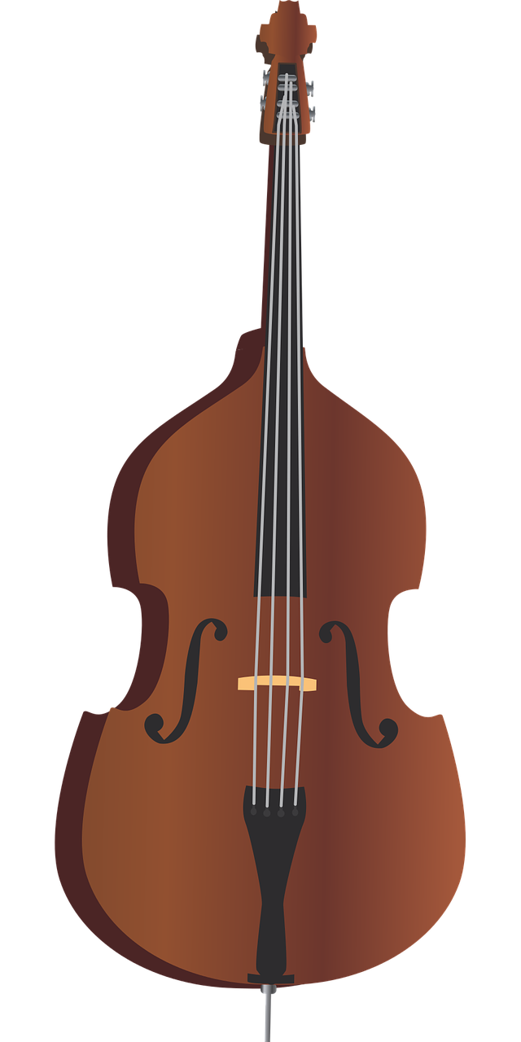
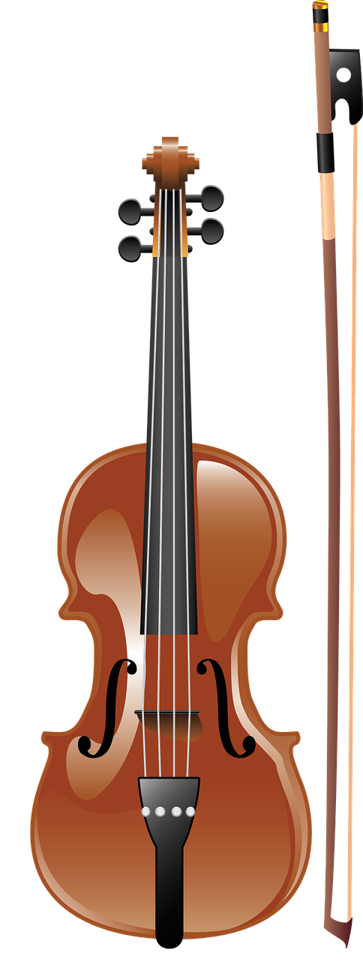
The bigger the instrument, the lower the sound.
The smaller the instrument, the higher the sound.

Slide 12
What is volume?

Slide 13


The volume of a sound is how loud or quiet the sound is.
It is all to do with the strength of a vibration.
A strong vibration
gives a sound wave lots of energy = a LOUD sound
For example if you hit a drum really hard!
A weak vibration
makes a gentle soundwave = a quiet sound
For example if you blow softly into a whistle.

Slide 14
Sound Quiz

Slide 15
1. Fill in the missing words
(a) Sounds are made when objects v _ _ _ _ _ _.
(b) The p _ _ _ _ of a sound is how high or low the sound is.
(c) The volume of a sound is how l _ _ _ or s _ _ _ it is.

Slide 16
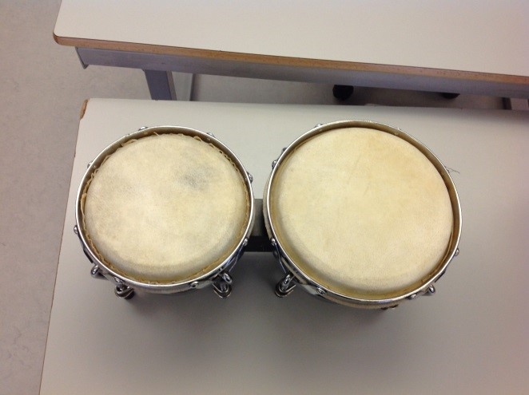
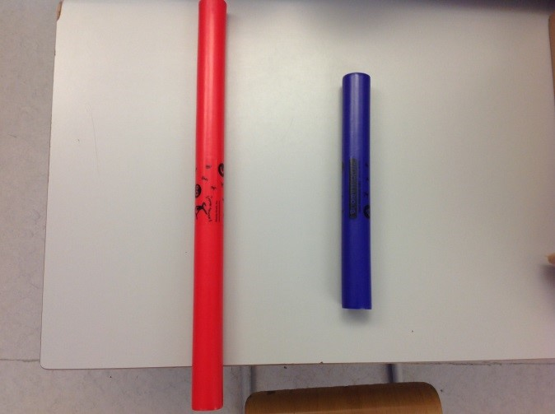
2. Look at these instruments. For each set, which one (the left or the right) would make the lowest pitch?
(a)
(b)

Slide 17
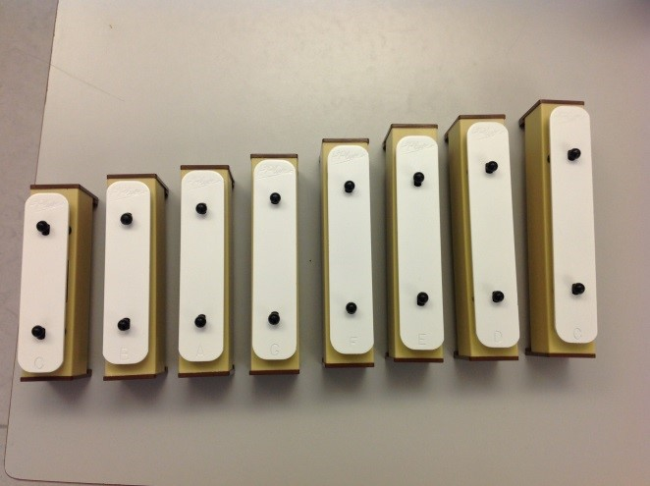
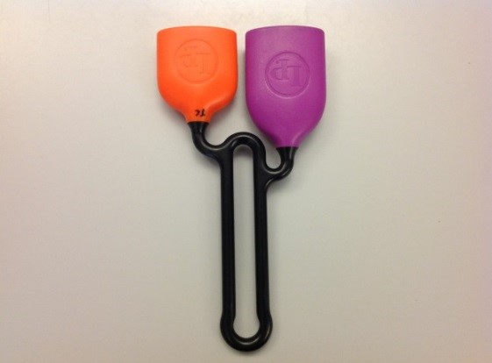
3. Look at these instruments. For each set, which one (the left or the right) would make the highest pitch?
(a)
(b)

Slide 18
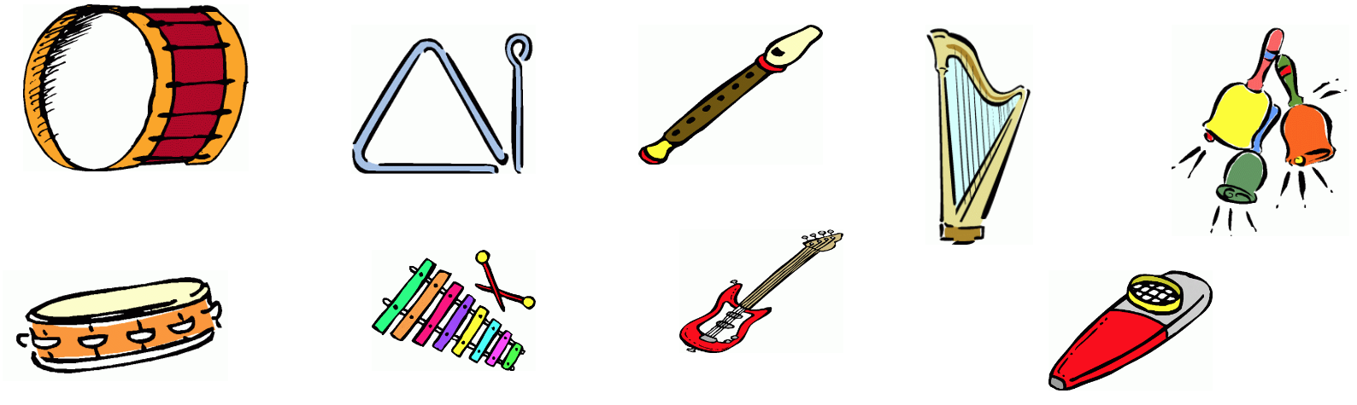
4. Sort these instruments according to how they are played.
Shake
Pluck
Bang
Blow

